Slide 1
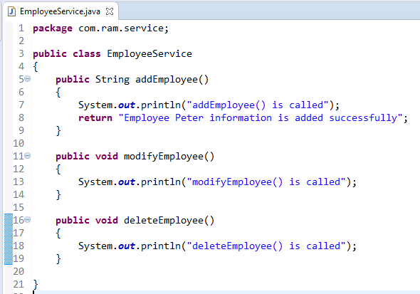
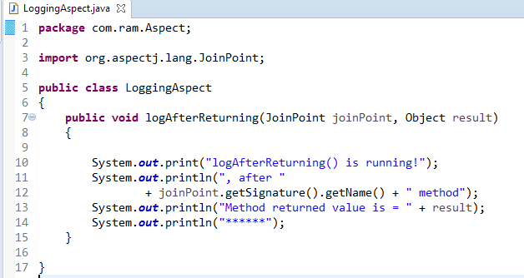
Spring AOP + AspectJ in XML configuration - AspectJ <aop:after-returning> = @After
@AfterReturning declares the after returning advice. It is executed after calling the actual method and after returning result. We can get the result value in the advice.
method
@AfterReturning
1
2

Slide 2
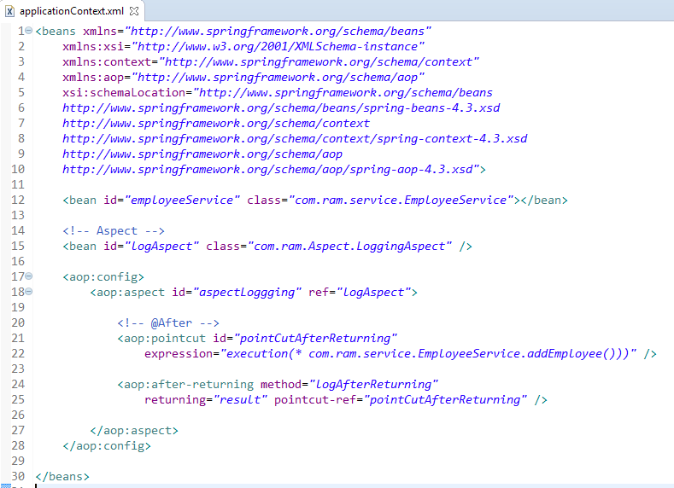
AspectJ <aop:after-returning> = @AfterReturning

Slide 3
